Slide 1
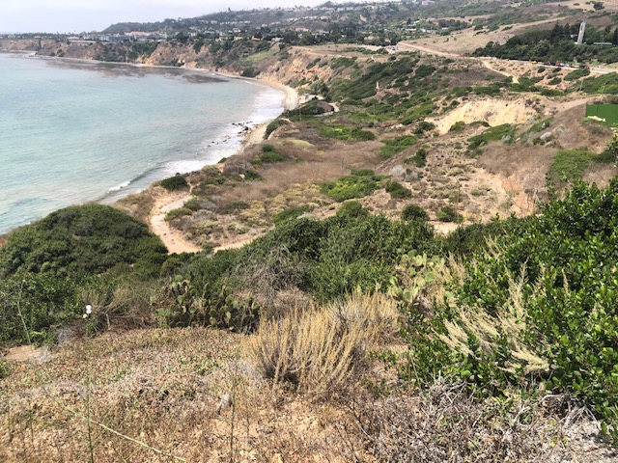
WELL STATUS August 14, 2023
CURRENTLY PUMPING 109K GPD
City Council approved $520K for re-drilling of city wells below PVDS
Met with Ramzi Awwad to layout well schedule and RPV Reqmts
Kerwin, Chiles, Leon located city wells in preparation for RFP
Goal to have wells installed by December
Fairchild drain line in work
Purchase 200’ Jet rooter to descale wells
Iron bacteria
Purchase 4 new well pumps and meters
Measured head pressure to optimize pumping
Well 4 -15psi, Well 11 -60psi, Well 8 – 10psi, other 0
Thanks to all the members that helped check the wells last week
Problems in work:
Wells 2, 3, 6 ,7, 16 not working
Well 8 and Yamaguchi need new meters
Wells 2, 3 need new box

