Slide 1
ACLAD Operations Status
7 May 2022

Slide 2
ACLAD STATUS
CURRENTLY PUMPING 89,000 GALLONS PER DAY
Drilled and developed well #4
Installing pump in progress
Replace pump at Well #1 (Narcissa-Ginger root)
Replaced pump at well #15 (Narcissa-Vanderlip)
Replaced pump at well #19 (end of Narcissa)
Re-developing well #3 (mid-Figtree)
ACLAD Near-term Plan
Well Drilling Plan: Well #7, Well #6
PVDS Systems Output Meter

Slide 3
Schraiber lessons
Cycle pumps < 6 times per hr, Run < 6-8 hrs then 1 hr rest
Add check valve near pump to reduce head pressure at start up
No weep holes
Add cooling sleeve around motor to cool motor and filter water
Discharge pipe: > 300’= 1.25”, <300’ = 1”
Pumps designed for clean water, dirty water = shorter life
Mount pumps 5’-10’ above well bottom or above mud
Do not run dry, use pump saver (Pump tech)

Slide 4
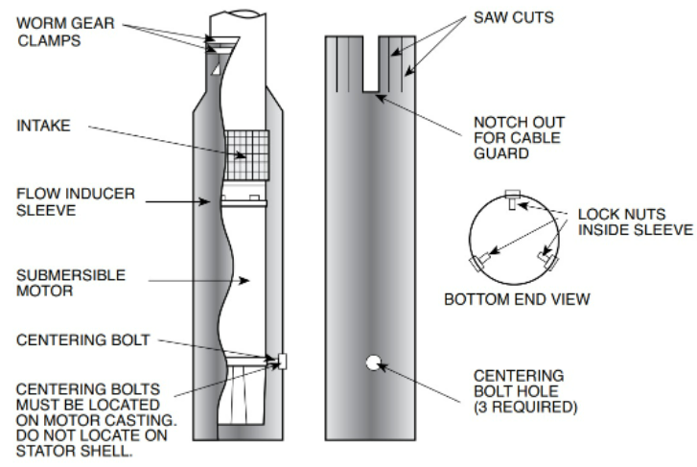
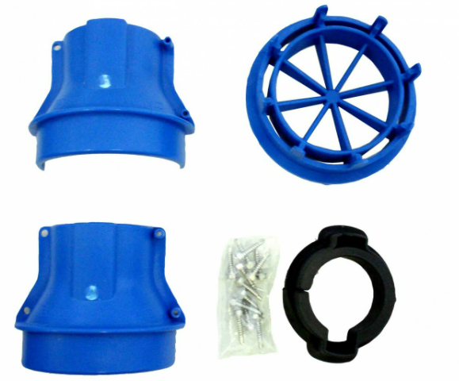

Slide 5
ACLAD Summary Report June 7, 2022

Slide 6
Weekly Well Monitoring (gallons per day)
 | Narcissa/Gingerroot | lower Narcissa | Beanfield | upper Gingerroot | King/Sweetbay | Narcissa/Vanderlip
 | 1 | 2 | 11 | 12 | 13 | 15
3-May | 0 | 5,089 | 11,433 | 12,903 | 14,206 | 6,035
10-May | 28,664 | 20,093 | 15,165 | 29,344 | 13,698 | 951
17-May | 12,554 | -8,663 | 3,827 | 27,571 | 13,675 | 5
24-May | 13,692 | 5,520 | 11,194 | 29,076 | 13,610 | -5
31-May | 17,064 | 5,200 | 11,221 | 24,934 | 13,590 | 7,885
7-Jun | 13,708 | 3,604 | 6,348 | 25,633 | 13,212 | 8,500
Petak/Sweetbay | Thyme | End of Narcissa | Sweetbay | Lower Figtree | Mid Sweetbay | Total GPD | PVDS Meter
16 | 17 | 19 | Yamaguchi | 3 | 8
3-May
10-May
17-May
24-May
31-May
7-Jun
859 | 0 | 0 | 3,109 | 0 | 62,053 | 98,494 | 98,494
-153 | 0 | 0 | 2,596 | 0 | 118,325 | 92,391 | 92,391
400 | 0 | 0 | 1,440 | 0 | 58,966 | 71,043 | 71,043
2,191 | 0 | 0 | 303 | 0 | 80,055 | 68,171 | 68,171
803 | 0 | 0 | 524 | 0 | 88,041 | 89,600 | 89,600
3,454 | 0 | 0 | 0 | 0 | 89,396 | 76,686 | 76,686

