Slide 1
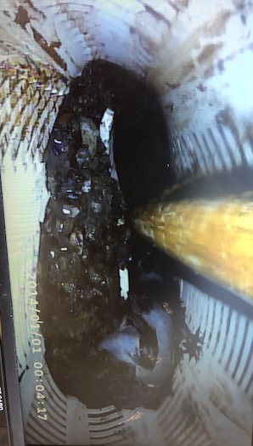
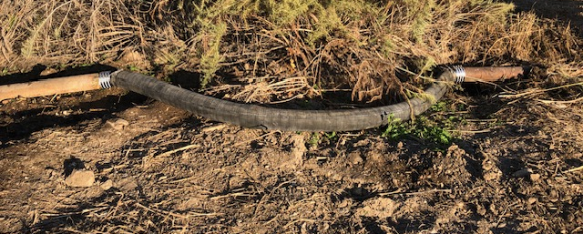
ACLAD Status 7/8/2024
Regular Maintenance
Well System Currently Shut Down due to 6” pipe break in Gateway Park
Multiple breaks due to land movement
Existing pipe in good condition
Experimenting with flex and swing joints to accommodate movement
WW 4, 7, 8, 21. 23 Sheered by land movement
Pumps stuck below sheer level
Discussing drain and electric cord removal to add new pump above old abandoned pump
Looking into alternate pump technologies
Replacing several meters jammed by debris, wells still producing
Well Casing
Collapsed casing at 66’
Flex line added to ACLAD main line drain
To accommodate land movement
Drain line to pump below
View looking
Down WW 4

Slide 2
ACLAD Status 7/8/2024
CURRENTLY PUMPING ~70,000 GPD
Average output lower due to frequent drain line breaks
Kelvin Canyon Spring
Drain line installed from spring to WW 15
Significant debris in water, Designing better filter
Need to chink leaks in Weir dam
Waiting parts for bypass to turn-off water during system maintenance
Other Activities
RPV Coordination meetings (Landslide WG and Cal Water
FEMA coordination for 1/31-2/9 Storm 4769
Rep Leu $1.1M Grant request past Appropriations Commitee
Response to Sen Butler for $12 Grant for Altamira Canyon Tuesday
Project Scoping Meeting at City Hall Thursday 7/10 10 am to 12
RPV Fast Track Loan: $1.61M approved by City Council
Hiring New Clerk (Sandy Marshal is retiring)

Slide 3
Fast Track Loan Project List
System Improvements |  |  | $K Cost Est
 | 1 | Four new and replaced de-watering wells (+2 wells in ACLAD Budget) | $750
 | 2 | Modify existing drainage system to add expansion joints at fissure locations and extended straight lengths | $150
 | 3 | Well Repairs and system optimization | $100
 |  |  | $1,000
Surface Drainage
 | 4 | Develop detailed conceptual plan and coordinate with gov't agencies to obtain BRIC or ACOE grants | $100
 | 5 | Line Altamira Canyon from Figtree drain to PVDS culvert | $150
 | 6 | Closing Fissures in residential area | $50
 | 7 | Improve drainage along Narcissa from the PBRC fissure to Narcissa and Ginger Root | $50
 | 8 | Improve drainage from Narcissa and lower Cinnamon to culvert | $45
 | 9 | Replace swale across the corner of the riding club between Upper Narcissa and Ginger Root | $65
 | 10 | Add curbing to Upper Cinnamon | $5
 | 11 | Modify drainage from Lower Cinnamon through Ride-to-fly and the adjacent lots | $50
 | 12 | Add curb to lower Vanderlip Dr and bridge stormwater across 3 major fissures on Upper Vanderlip Dr | $40
 | 13 | Repair and replace the deep swale along figtree to direct the stormwater flow to the culvert | $80
 | 14 | Lengthen Thyme Swale into Altamira Canyon | $20
 | 15 | Add Curbing around 30 Narcissa | $5
 |  |  | $660
Total |  |  | $1,660
All projects to be vetted with GeoTech and RPV for landslide mitigation

Slide 4
Individual well status: 7/2/24
WW | Location | GPM | Comments
1 | Narcissa/Ginger Root | 3,299
2 | Lower Narcissa | 1,351 | Pipe break by Narcissa
3 | Figtree | 898 | Needs new box and wiring
4 | Lower Figtree | 0 | Sheared
6 | Clove Tree | 5,049 | Need to remove plumbing from new well
7 | Mid Narcissa | 0 | Sheared Need to remove plumbing
8 | Mid Sweetbay | 0 | Sheared
9 | Beach School | 7,000
10 | Figtree Cul de sac | 2,975 | Pumping rate low, Investigating
11 | Bean Field | 13,035
12 | Upper Ginger Root | 12,000 | Need to replace meter

Slide 5
Individual well status
WW | Location | GPM | Comments
13 | King/Sweetbay | 15,730 | Multiple line breaks, revising flex joint
15 | Vanderlip/Narcissa | 1,608 | Investigating low production
16 | Petak/Sweetbay | 0 | Problem with pump or check valves, investigating
17 | Thyme | 0 | Just stopped working, investigating
18 | Olmsted | 407 | Leak in drainage line
19 | Beach School | 4,022
20 | Olmsted | 5,372
21 | Sweetbay/Yamaguchi | 0 | Sheared
22 | End of Narcissa | 0 | Zelhart fixing drain line
23 | Narcissa/Altamira | 0 | Sheared
24 | Narcissa/Hunter | 19,173

