Slide 1
ACLAD Operations Status
10 May 2022

Slide 2
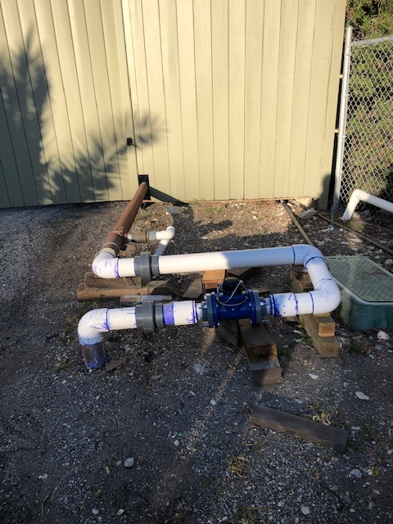
ACLAD STATUS
CURRENTLY PUMPING 87,215 GALLONS PER DAY
New box on PVDS System Output Meter
Well #6 (Clove Tree)
Power permits in work for new pole and hook-up
Ran pump on Tim and Coleen Miller’s Hot Tub circuit
Well # 1 (Ginger Root)
Replaced pump
Well # 19 (end of Narcissa)
Replacing Pump on Saturday
Discussed pump problems with Schraiber. Received several recommendations
ACLAD Near-term Plan
Well #4 (lower Figtree) ABC Drilling to start pending Board Approval
Well Drilling Plan: Well #4, Well #7, Well #6 or #3
PVDS Systems Output Meter

Slide 3
ACLAD Summary Report May 10, 2022

Slide 4
Weekly Well Monitoring (gallons per day)
 | Narcissa/Gingerroot | lower Narcissa | Beanfield | upper Gingerroot | King/Sweetbay | Narcissa/Vanderlip
 | 1 | 2 | 11 | 12 | 13 | 15
5-Apr | 17,631 | 4,207 | 23,840 | 17,343 | 2,888 | 11,134
12-Apr | 17,214 | 4,230 | 11,733 | 17,019 | 9,184 | 11,660
19-Apr | 16,893 | 4,600 | 11,093 | 13,750 | 14,065 | 11,626
26-Apr | 5,751 | 4,926 | 11,145 | 0 | 14,014 | 11,660
3-May | 0 | 5,089 | 11,436 | 12,903 | 14,206 | 6,749
10-May | 14,332 | 5,816 | 15,162 | 27,916 | 13,734 | -714
Petak/Sweetbay | Thyme | End of Narcissa | Sweetbay | Lower Figtree | Mid Sweetbay | Total GPD | PVDS Meter
16 | 17 | 19 | Yamaguchi | 3 | 8
5-Apr
12-Apr
19-Apr
26-Apr
3-May
10-May
8,264 | 857 | 0 | 3,373 | 4,303 | 0 | 86,165 | 77,743
13,804 | 849 | -1 | 11,984 | 3,799 | 0 | 85,692 | 81,757
7,061 | 843 | 1,239 | 23,299 | 1,677 | 0 | 81,170 | 82,586
9,941 | 836 | 0 | 17,594 | 4,504 | 0 | 58,273 | 66,100
11,529 | 298 | 0 | 21,543 | 3,107 | 0 | 62,210 | 98,494
10,561 | 407 | 0 | 0 | 2,597 | 0 | 87,215 | 92,391

